Slide 1

CAR RENTAL SYSTEM

Slide 2
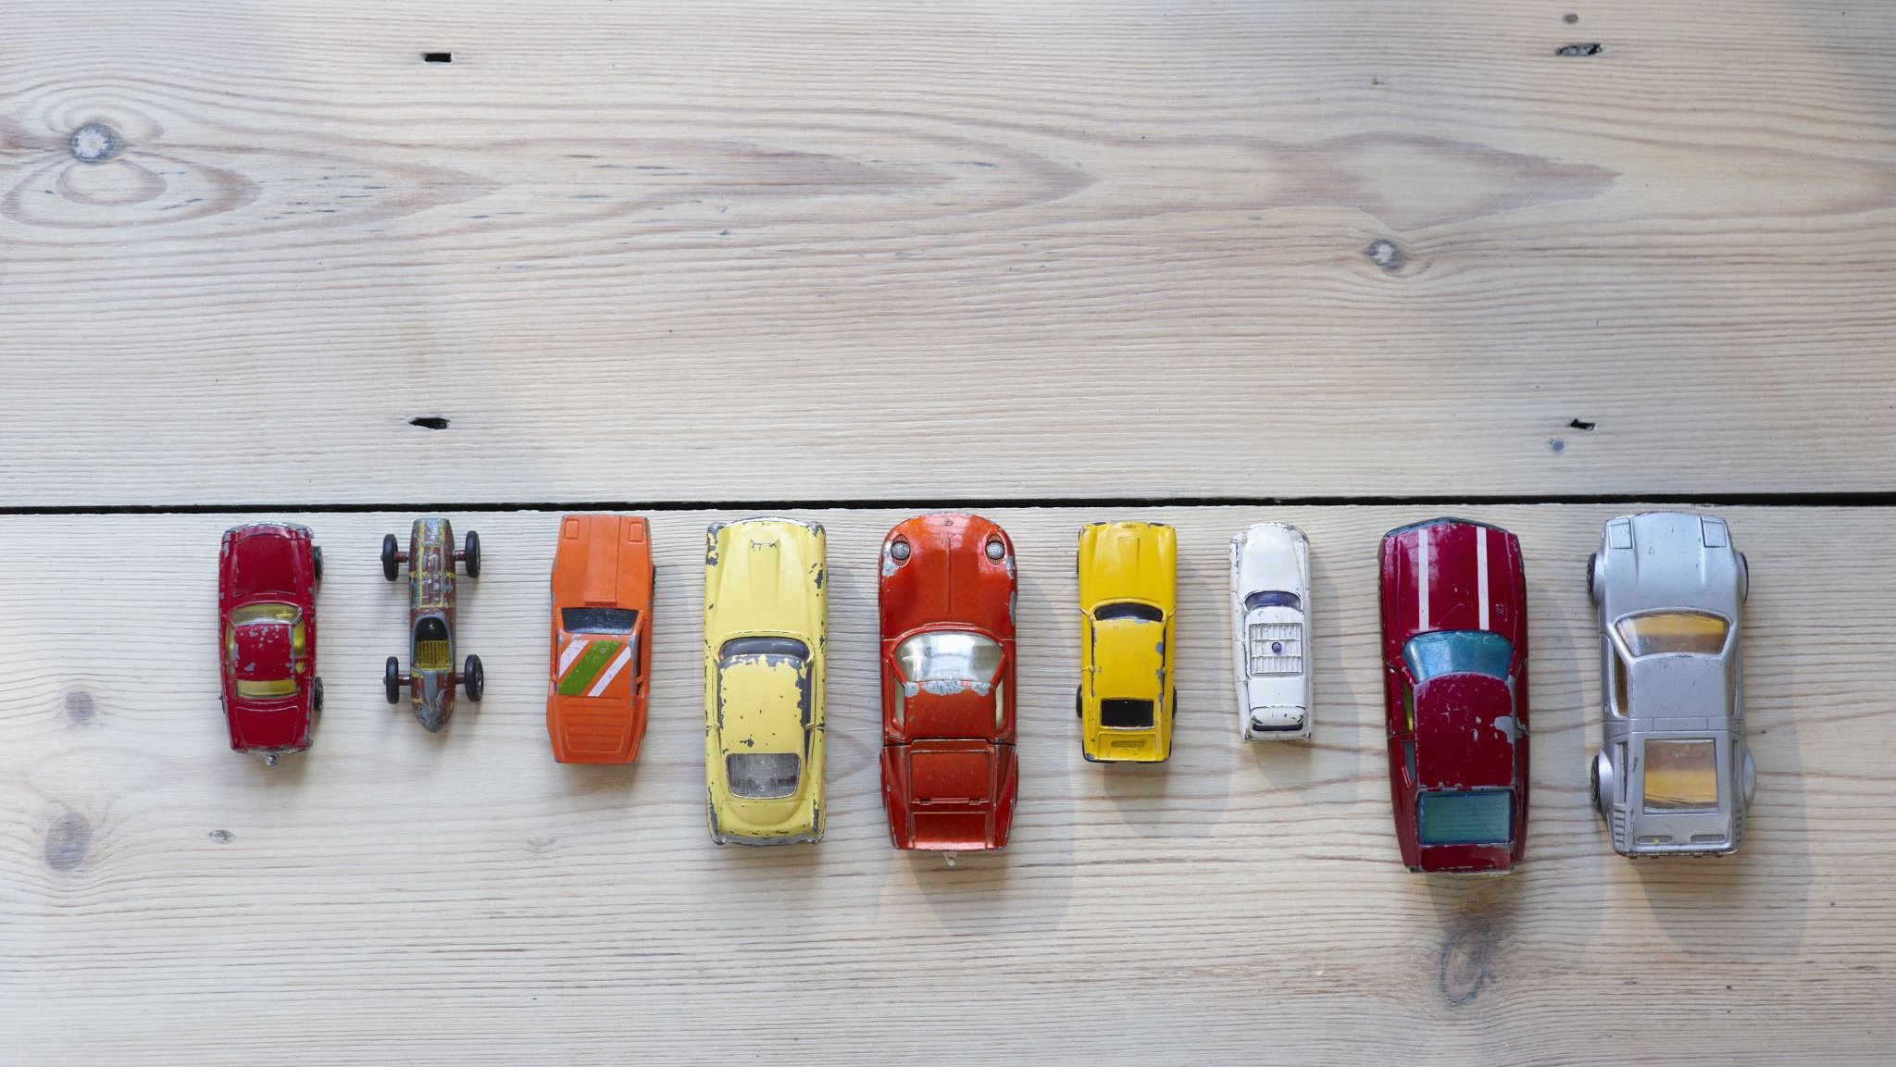
INTRODUCTION
This project is designed so as to be used by Car Rental Company specializing in renting cars to customers.
It is an online system through which customers can view available cars, register, view profile and book car.

Slide 3

OBJECTIVE
To produce a JAVA-based system that allow customer to register and reserve car online and for the company to effectively manage their car rental business.
To ease customer’s task whenever they need to rent a car.

Slide 4
DESIGN
Swing : Swing is a GUI widget toolkit for Java
JDBC :JDBC stands for Java Database Connectivity, which is a standard Java API for database-independent connectivity between the Java programming language and a wide range of databases.
JFrame : JFrame class is a type of container which inherits the java.awt.Frame class. JFrame works like the main window where components like labels, buttons, textfields are added to create a GUI.
JButton : The JButton class is used to create a labeled button that has platform independent implementation. The application result in some action when the button is pushed. It inherits AbstractButton class.
JRadioButton :The JRadioButton class is used to create a radio button. It is used to choose one option from multiple options.

Slide 5
JLabel : The object of JLabel class is a component for placing text in a container. It is used to display a single line of read only text. The text can be changed by an application but a user cannot edit it directly. It inherits JComponent class.
Java JTextField : The object of a JTextField class is a text component that allows the editing of a single line text. It inherits JTextComponent class.
JPasswordField : The object of a JPasswordField class is a text component specialized for password entry. It allows the editing of a single line of text. It inherits JTextField class.
JScrollPane : A JscrollPane is used to make scrollable view of a component. When screen size is limited, we use a scroll pane to display a large component or a component whose size can change dynamically.
JTable : The JTable class is used to display data in tabular form. It is composed of rows and columns.
DESIGN

Slide 6
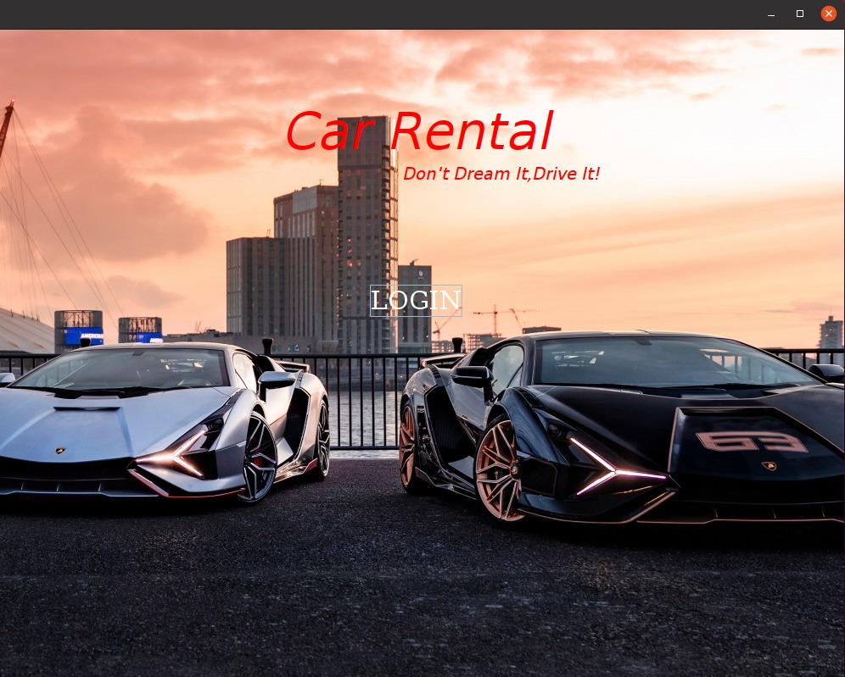

FRAME 1
INTROduction page

Slide 7
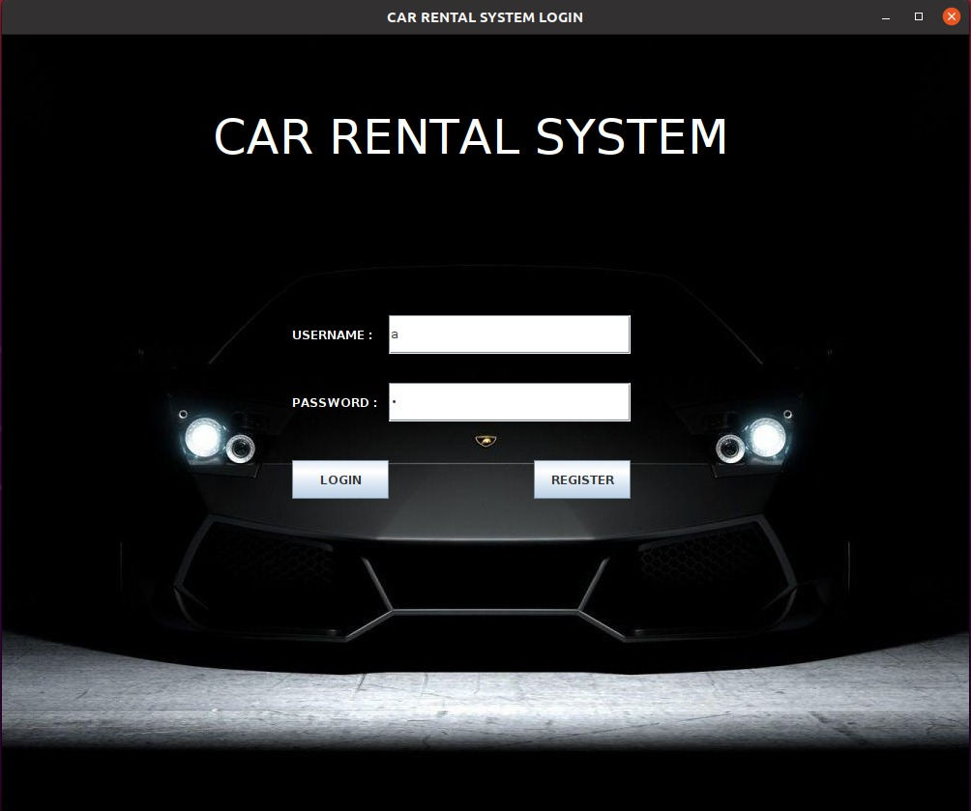
FRAME 2
LOGIN PAGE FOR CUSTOMER

Slide 8
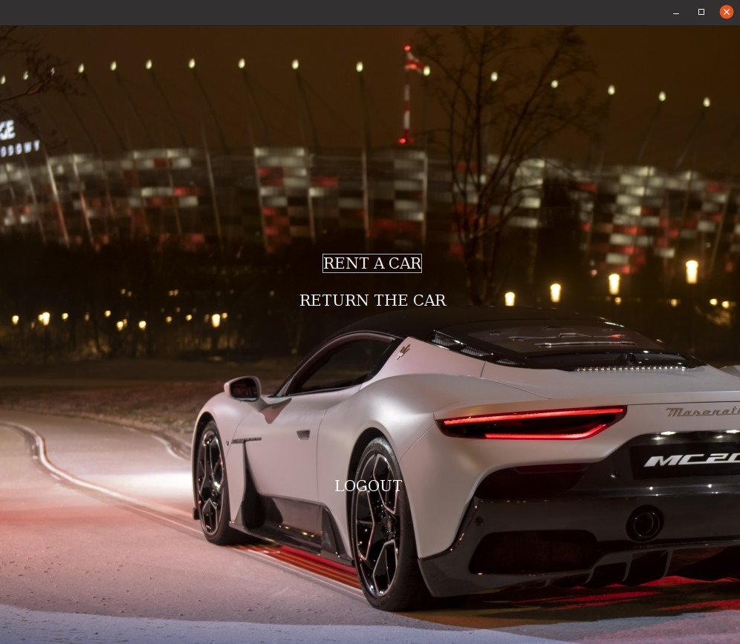
FRAME 3
PAGE TO RETURN A CAR OR RENT A CAR

Slide 9
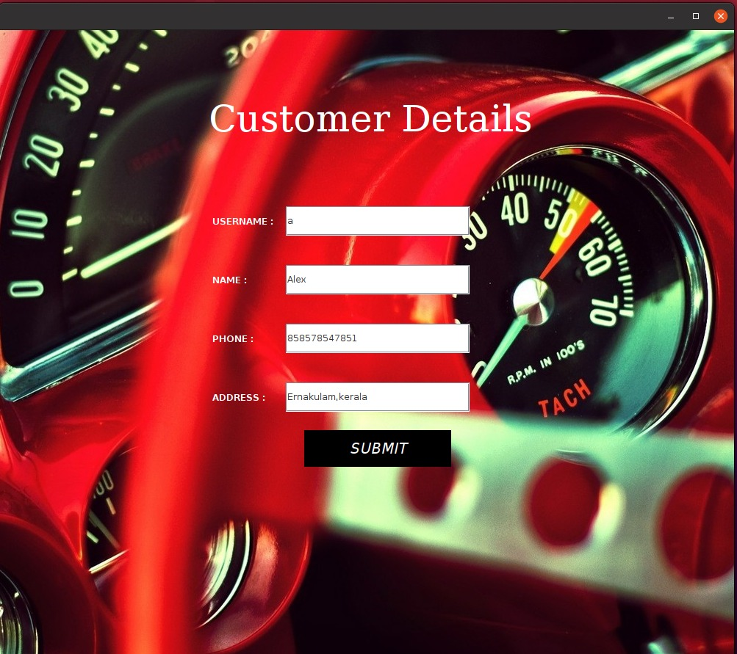
FRAME 4
A PAGE FOR CUSTOMER DETAILS

Slide 10
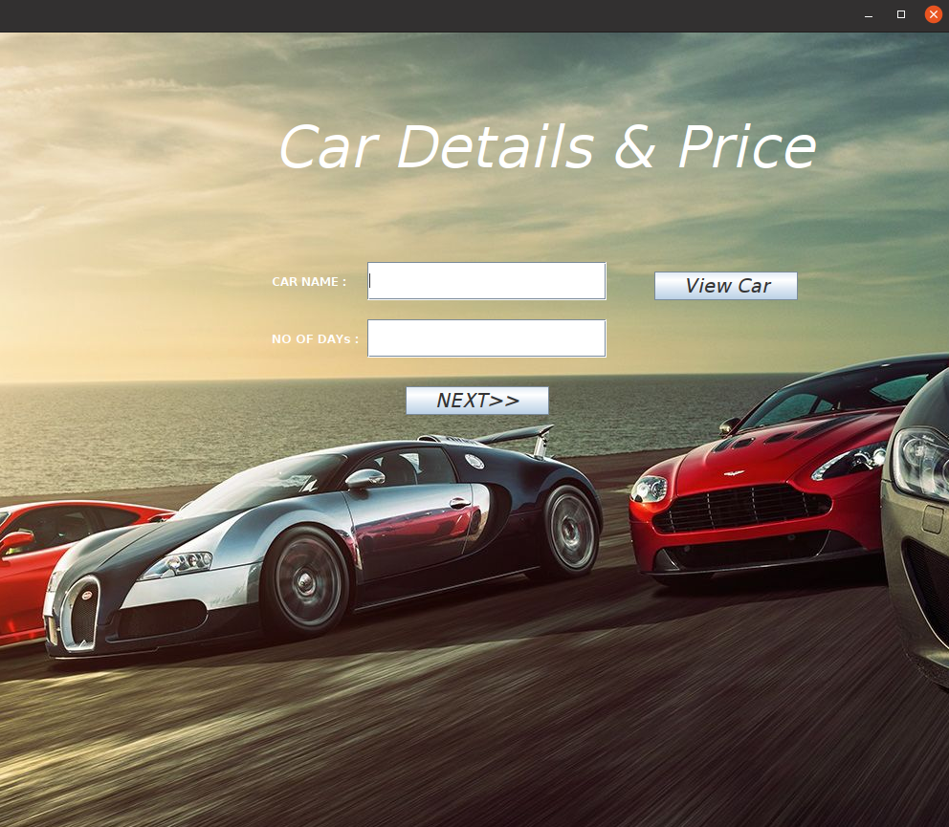
FRAME 5
A PAGE FOR CAR DETAILS AND PRICE.

Slide 11
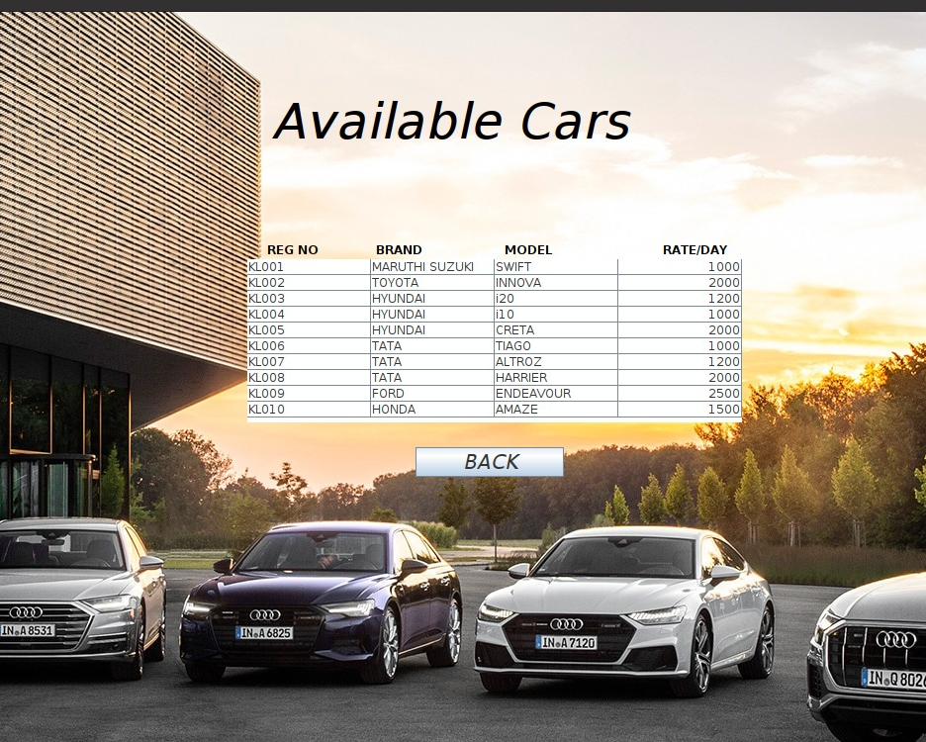
FRAME 6
A PAGE FOR THE AVAILABLE CARS

Slide 12
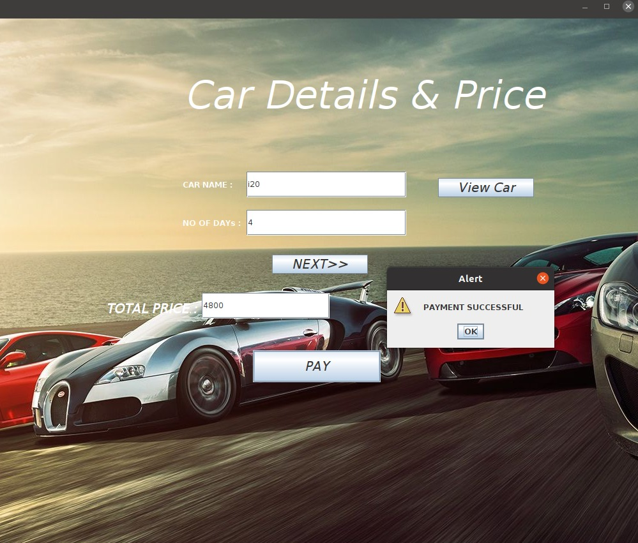
FRAME 7
A PAGE FOR PRICE AND PAYMENT.

Slide 13
FRAME 8
PAGE FOR RETURN A CAR

Slide 14
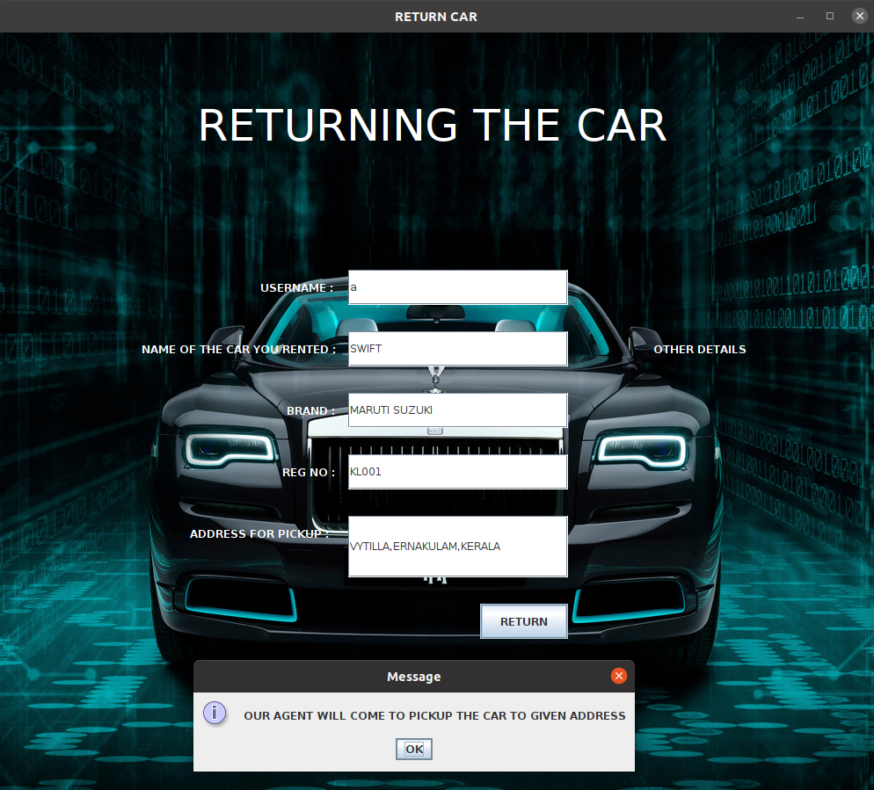
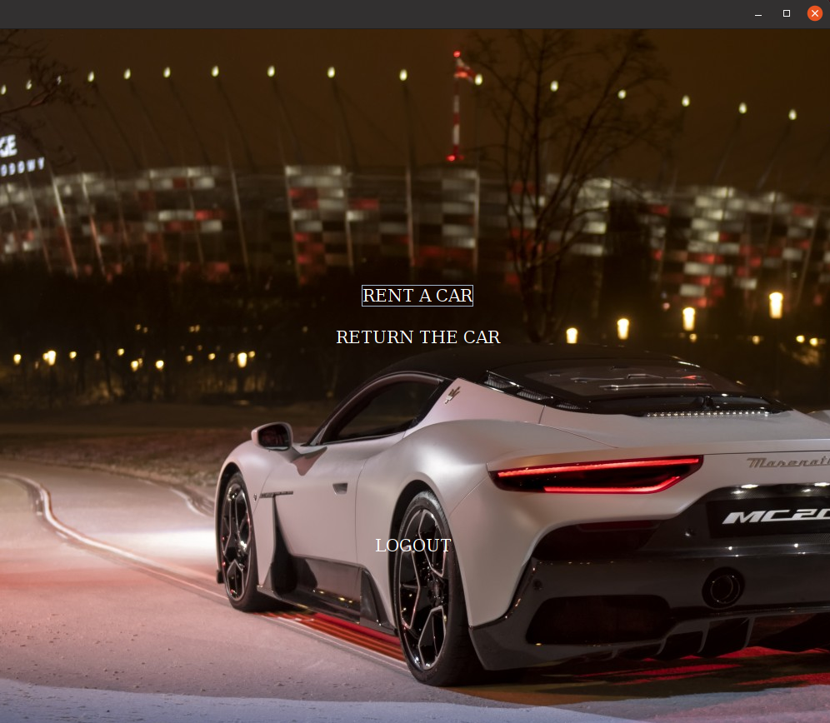
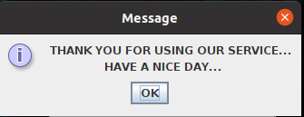
FRAME 9
A PAGE FOR RETURNING THE BOOKED CAR.
FRAME 10

Slide 15
IMPLEMENTATION
For the ease of customers to rent and return a car from his doorsteps.
It helps in back office administration by streamlining and standardizing the procedures.
To reduce unnecessary paper works during the rental procedure.

Slide 16
FUTURE SCOPE
Services like-
This online car rental solution is fully functional and flexible.
It is very easy to use.
This online car rental system helps in back office administration by streamlining and standardizing the procedures.
It saves a lot of time, money and labour.
Eco-friendly: The monitoring of the vehicle activity and the overall business becomes easy and includes the least of paper work.
The software acts as an office that is open 24/7.
It increases the efficiency of the management at offering quality services to the customers.
It provides custom features development and support with the software.

Slide 17

CONCLUSION
Car rental business has emerged with a new goodies compared to the past experience where every activity concerning car rental business is limited to a physical location only. Even though the physical location has not been totally eradicated; the nature of functions and how these functions are achieved has been reshaped by the power of internet. Nowadays, customers can reserve cars online, rent car online, and have the car brought to their door step once the customer is a registered member or go to the office to pick the car.
The web based car rental system has offered an advantage to both customers as well as Car Rental Company to efficiently and effectively manage the business and satisfies customers’ need at the click of a button..

Slide 18
DON’T DREAM IT, DRIVE IT!
PROJECT BY,
JERIN PAUL
ATHUL KRISHNA
ASWIN ALEX REXY

Slide 19
☺
THANK
YOU

